Slide 1
Epidemiological methods
Unit 3

Slide 2
Study designed is a specific plan or protocol for conducting the study which allows the investigator to translate conceptual hypothesis into and operational use.
It primarily concerns on to study disease occurrence in people, during the course of their live are exposed to various factors and circumstances and some may have a role in disease etiology.
It is the study of the distribution and determinants of health- related states or events and the application of this study to control the disease and other health problem

Slide 3
Epidemiological study design is needed for…
Identification of the health need
Formulate hypothesis
Examine the pattern of disease
Look for the cause
Formulate health promotion, prevention and control strategy
Study the natural history of disease
Plan for the health service
Evaluate the health services
Develop priorities etc.

Slide 4
Broadly epidemiological study are classified:
Experimental studies
Observational (non-experimental) studies

Slide 5
Basic Types of studies
1. Observational
Descriptive Studies
Case studies
Case series
Ecological studies
Analytical Studies
Cross-sectional studies
Case-control
Cohort
2. Experimental Studies
Randomized control trial
Quasi-experimental
Community trial

Slide 6
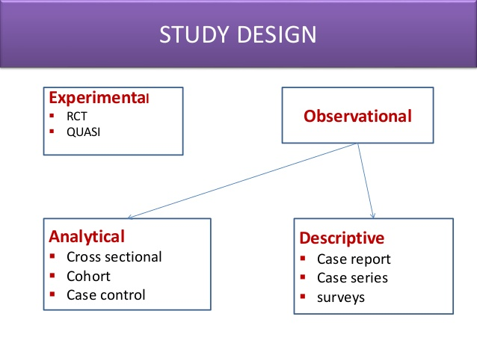

Slide 7
Experimental studies
Randomized controlled trial (RCT) or clinical trials(with patients as unit of study)
Observational or non-experimental studies
Descriptive studies
Field trials or community interventional study (with health people as unit of study)
Community trials (with community as unit of study)
Analytical studies: case-control studies, cross sectional studies, cohort studies, ecological studies

Slide 8
Basic Types of Studies
Descriptive studies
describe occurrence/frequency of problem
Analytic studies
describe association between exposure (cause) and outcome (effect)
Experimental/Interventional studies
-a effect of a intervention/manipulation is measured

Slide 9
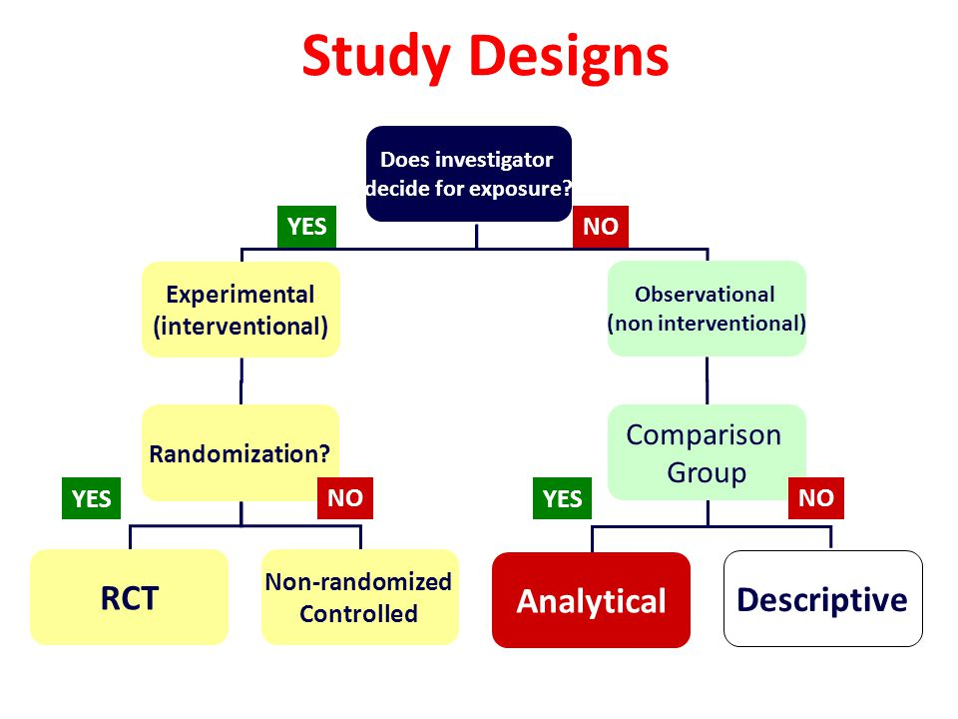

Slide 10
Observational Studies
Non-experimental
Observational because there is no individual intervention
individuals can be observed prospectively, retrospectively, or currently

Slide 11
Descriptive Studies

Slide 12
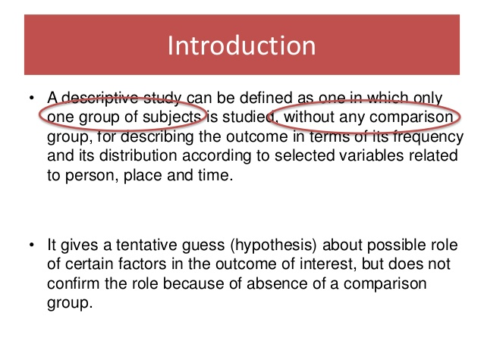

Slide 13
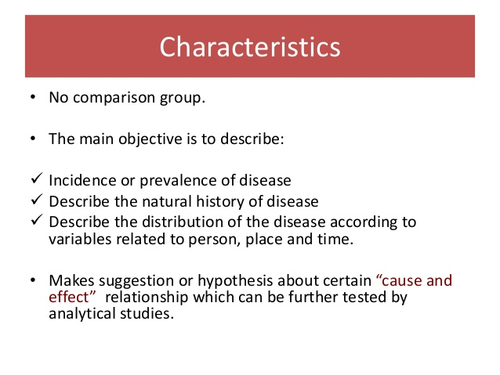

Slide 14
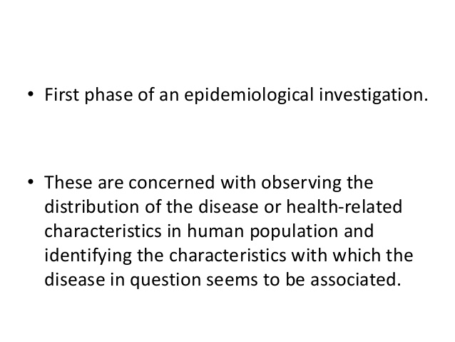

Slide 15
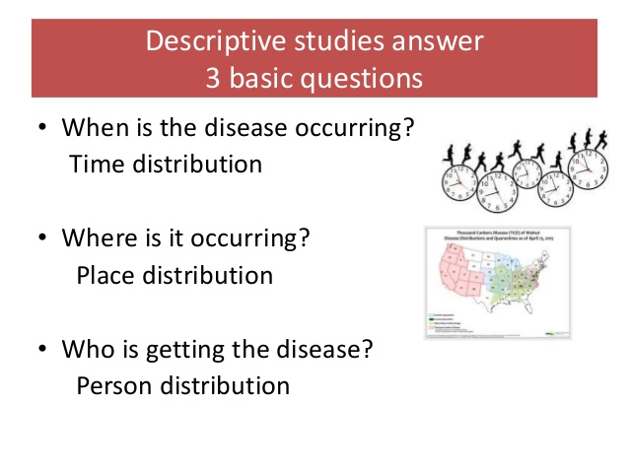

Slide 16
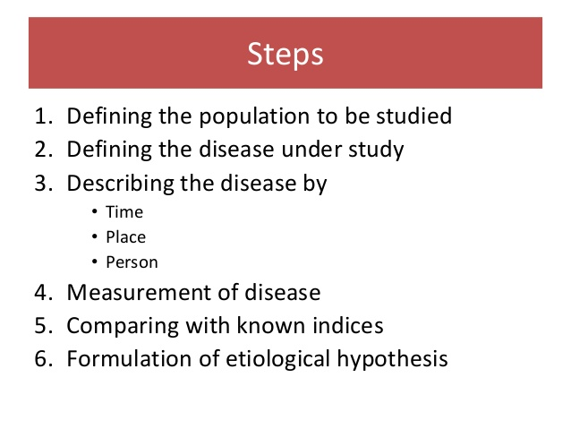

Slide 17
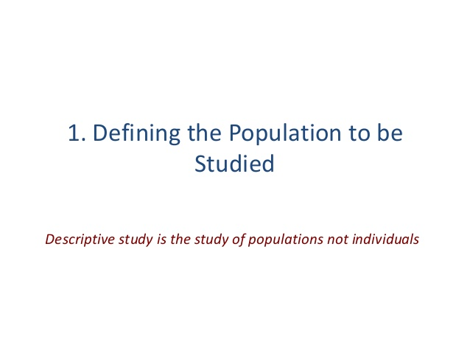

Slide 18
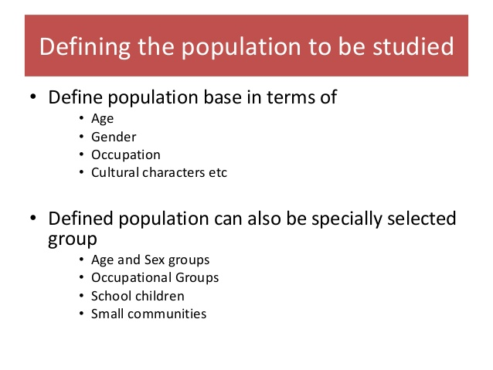

Slide 19
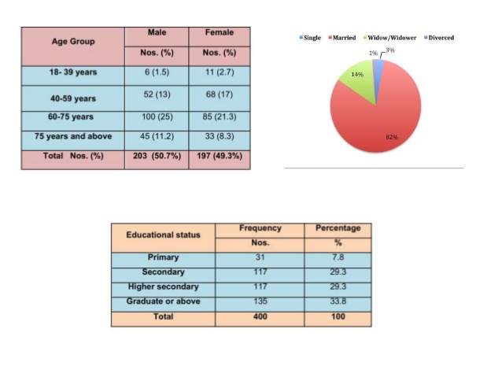

Slide 20
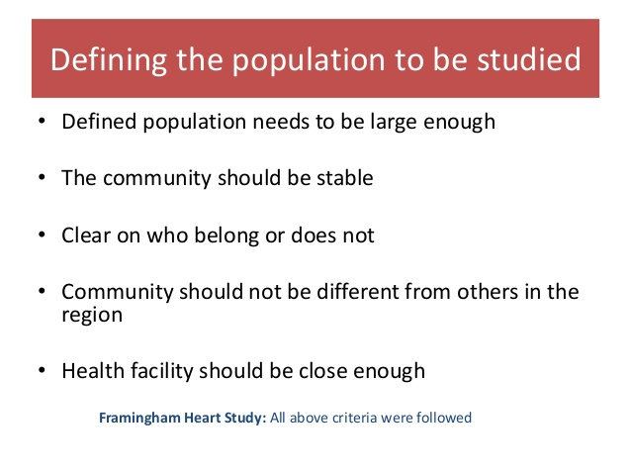

Slide 21
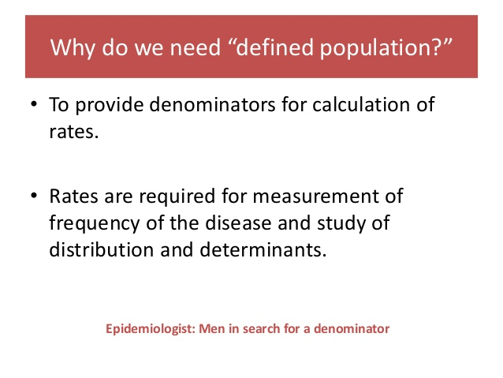

Slide 22
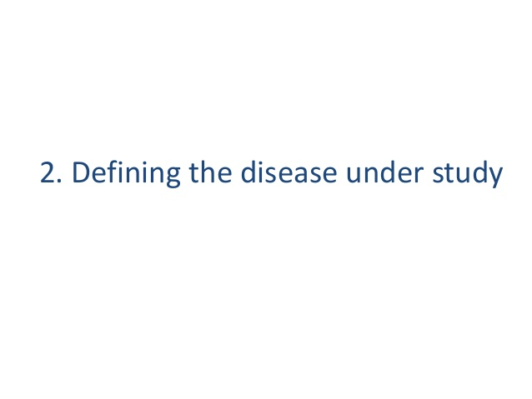

Slide 23
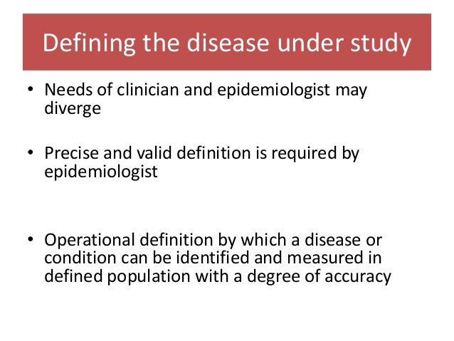

Slide 24
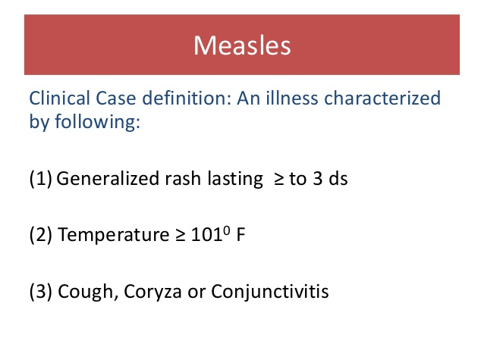

Slide 25
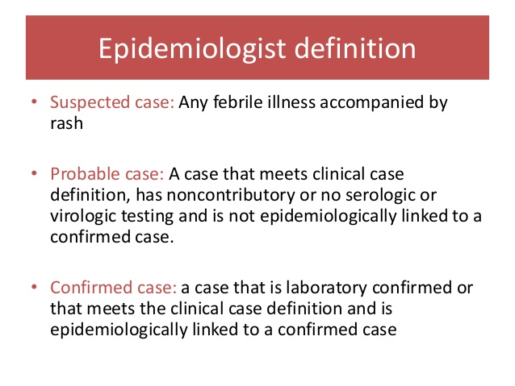

Slide 26
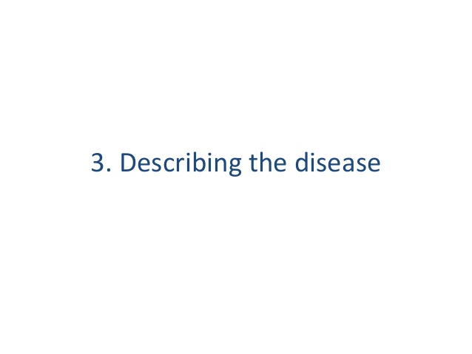

Slide 27
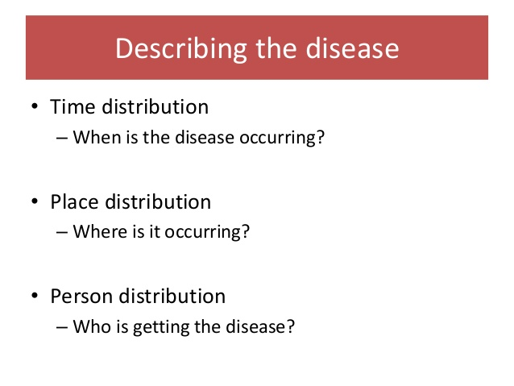

Slide 28
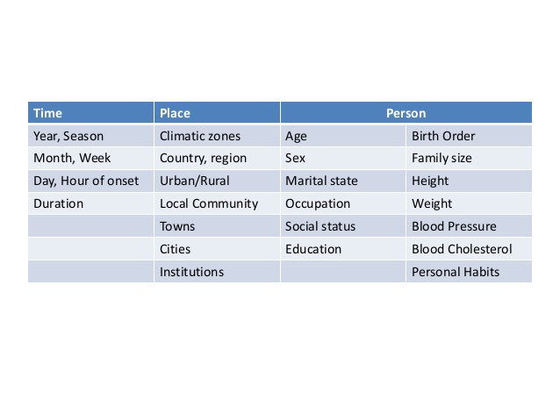

Slide 29
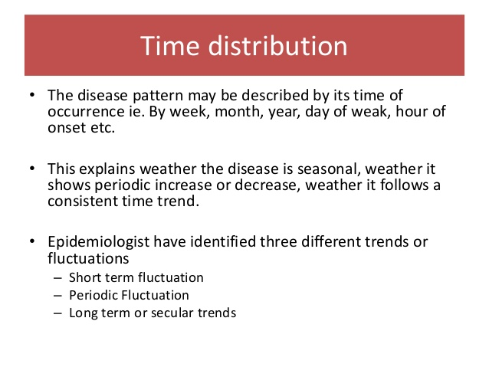

Slide 30
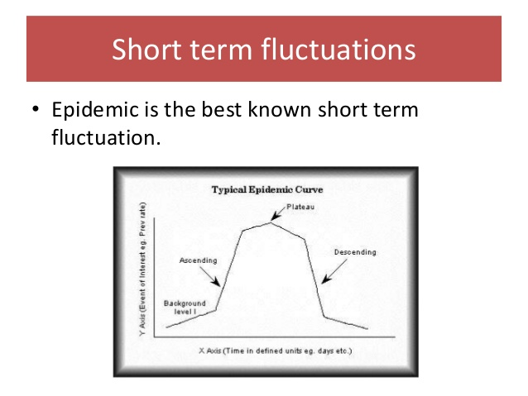

Slide 31
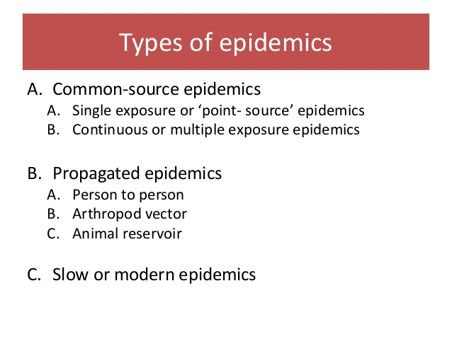

Slide 32
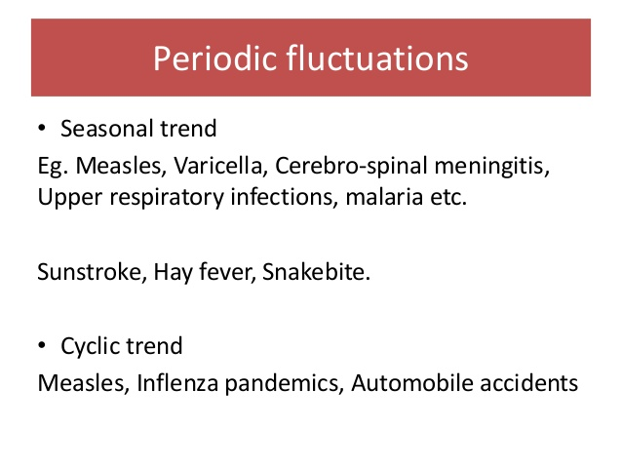

Slide 33
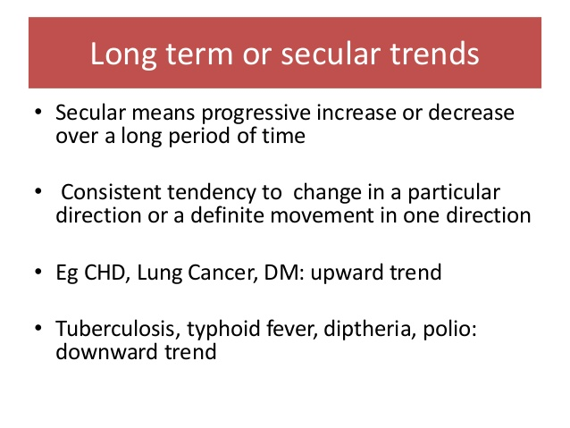

Slide 34
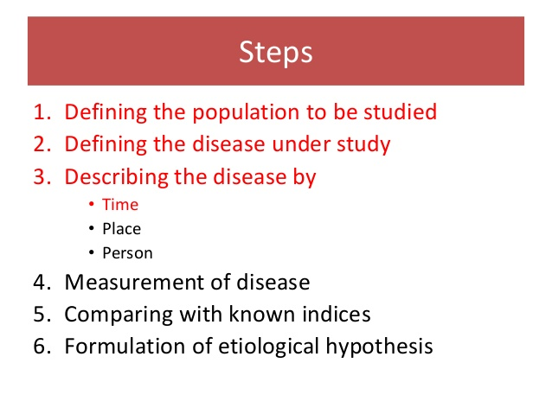

Slide 35
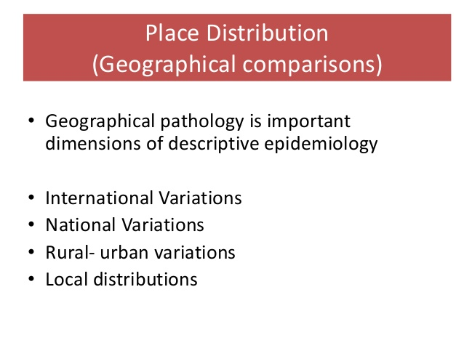

Slide 36
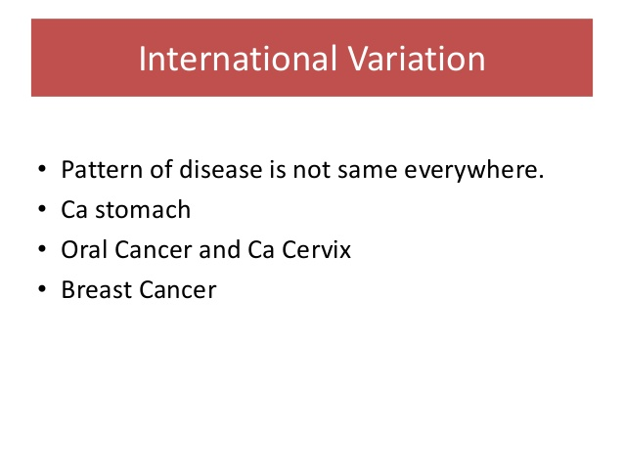

Slide 37
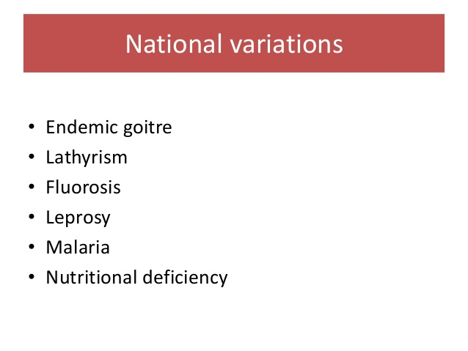

Slide 38
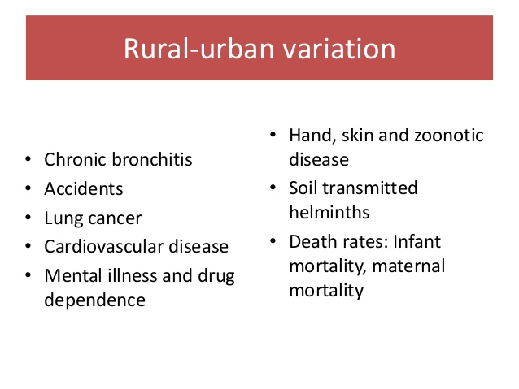

Slide 39
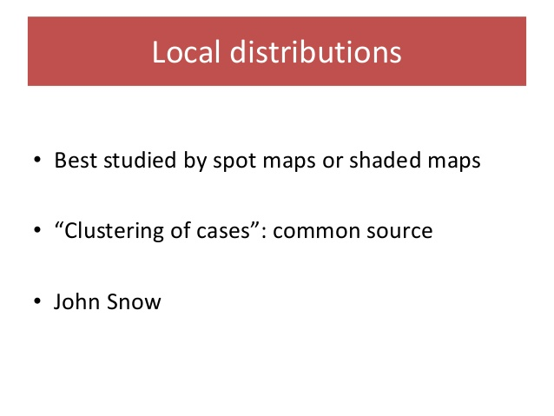

Slide 40
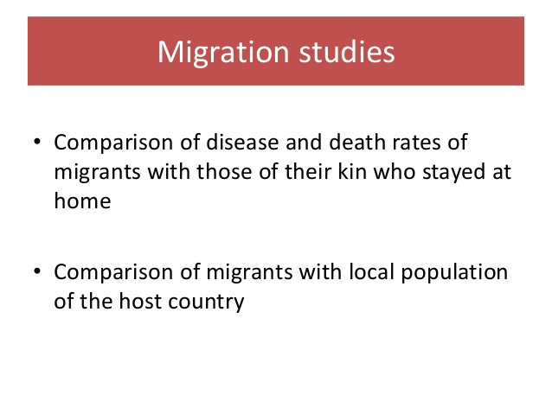

Slide 41
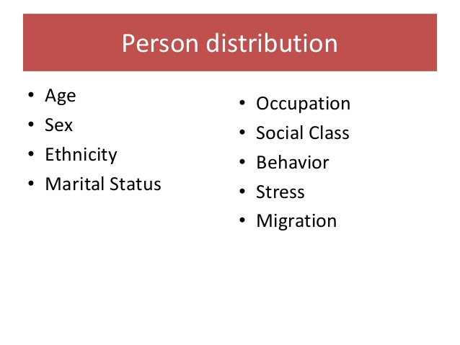

Slide 42
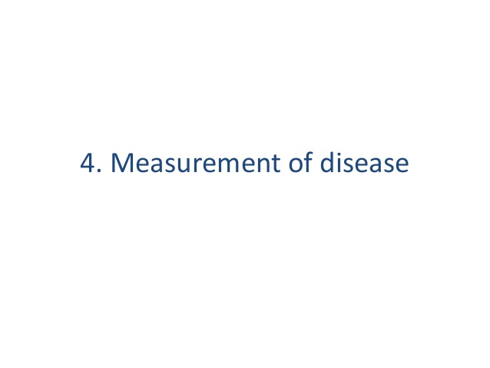

Slide 43
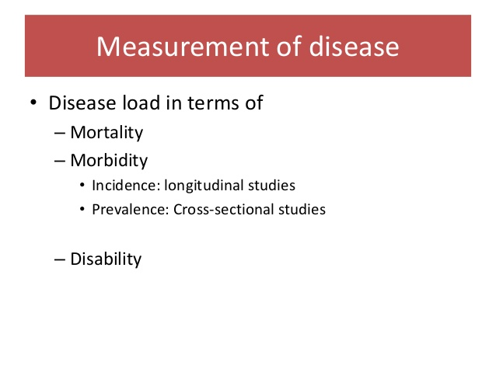

Slide 44
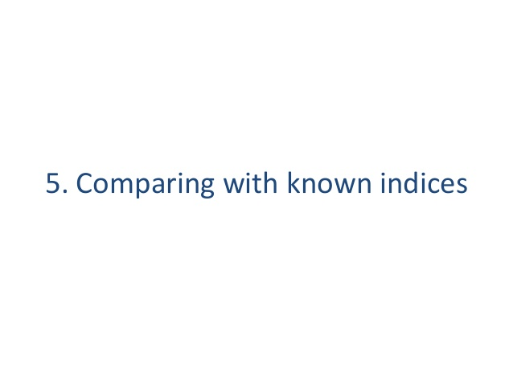

Slide 45
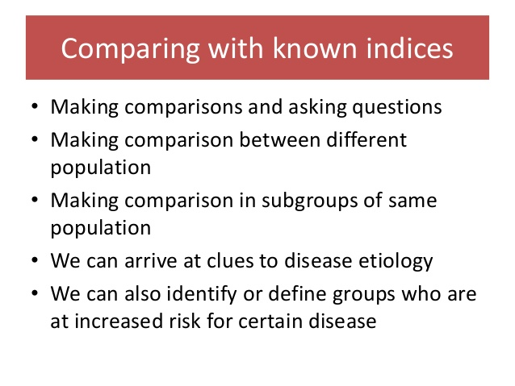

Slide 46
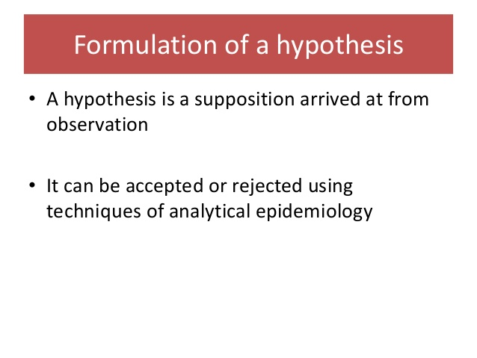

Slide 47
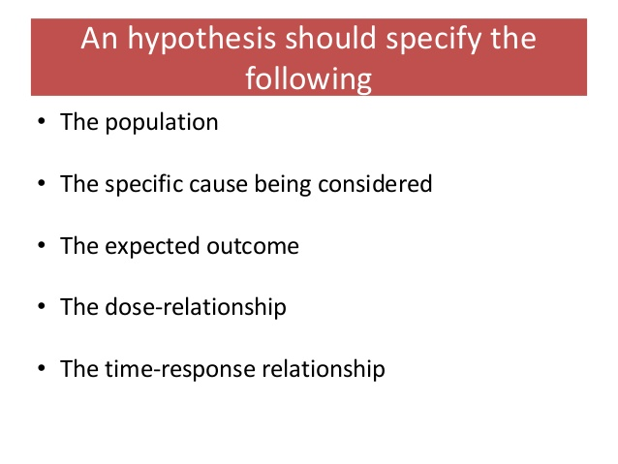

Slide 48
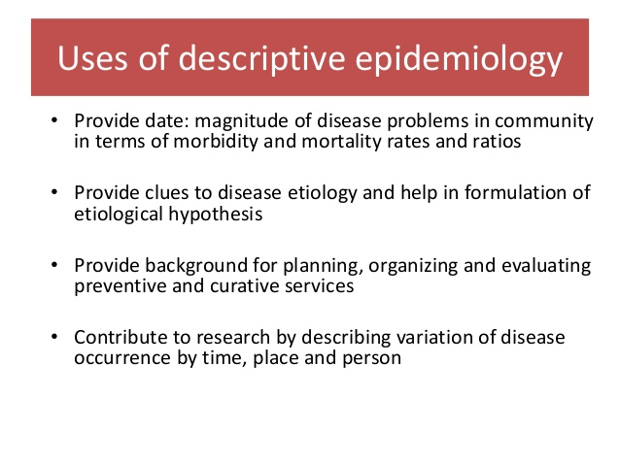

Slide 49
Descriptive study
A simple description of the health status of a community, based on routinely available data or on data obtained in special surveys, is often the first step in an epidemiological investigation. Such a study is termed as a descriptive study.
A descriptive study – as the name implies – describes the distributions of disease, injury or health in a population, outlining the burden of disease or the extent of exposure.
Pure descriptive studies make no attempt to analyze the links between exposure and effect.
They summarize patterns of disease or of disease determinants in terms of time, place and person.

Slide 50
Descriptive study
They are usually based on mortality statistics and may examine patterns of death by age, sex, race or ethnicity during specified time periods or in various countries.
They describe a health outcome by different characteristics of a person (race, age, or sex, for example), place (geographic location), and time (a specific year or a span of time). For example, the case fatality of cholera in 1854 in London was 40% (John Snow, the cholera outbreak in London).
The results are used to understand a population’s health status, generate hypotheses about the causes of diseases, and inform program planning and evaluation. In other words, descriptive epidemiology describes the distribution of disease

Slide 51
The types of descriptive studies include:
case report or case series
correlation or ecologic studies
cross-sectional studies

Slide 52
Descriptive study
Descriptive studies that examine individuals can take the form of case reports (a report of a single case of an unusual disease or association), case series (a description of several similar cases) and cross-sectional studies.
Descriptive studies that examine populations, or groups, as the unit of observation, are known as ecological studies.

Slide 53
Case Reports
Detailed presentation of a single case or handful of cases
Generally report a new or unique finding
e.g. previous undescribed disease
e.g. e.g. unexpected new therapeutic effect
e.g. adverse events

Slide 54
Case Series
Experience of a group of patients with a similar diagnosis
Cases may be identified from a single or multiple sources
Generally report on new/unique condition
May be only realistic design for rare disorders

Slide 55
One case of unusual
findings
Case Report
Multiple cases of
findings
Case Series
Descriptive
Study
Population-based
cases with denominator

Slide 56
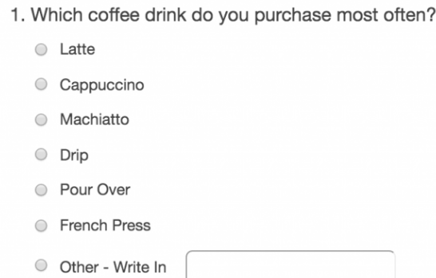
32% usually purchase Cappuccino

Slide 57
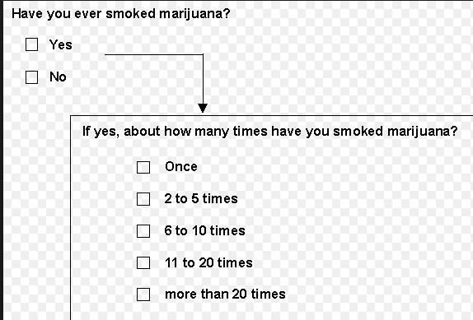

Slide 58
A cross-sectional survey may be purely descriptive and used to assess the burden of a particular disease in a defined population.

Slide 59
Applications of Descriptive Studies
Descriptive epidemiology identifies non-random variation in the distribution of disease, injury or health.
Their function is to describe the “who, what, why, when, where” without regard to the hypothesis, highlighting patterns of disease and associated factors.
This allows the public health practitioner to generate testable hypotheses regarding why such variation occurs.
Descriptive epidemiology identifies who is affected, when, and where the situation is occurring in the community or population of interest. This is an important tool for health services planning and programming.
Pure descriptive studies are rare, but descriptive data in reports of health statistics are a useful source of ideas for epidemiological studies.
Limited descriptive information (such as that provided in a case series) in which the characteristics of several patients with a specific disease are described but are not compared with those of a reference population, often stimulates the initiation of a more detailed epidemiological study.

Slide 60
Advantages of Descriptive Studies
Descriptive (including ecological) studies are generally relatively quick, easy and cheap to conduct.
Exposure data often only available at the area level.
Differences in exposure between areas may be bigger than at the individual level, and so are more easily examined.
Utilization of geographical information systems to examine the spatial framework of disease and exposure

Slide 61
Limitations
A descriptive study is limited to a description of the occurrence of a disease in a population.
It is unable to test hypotheses.
Weaknesses of case reports and case series are that they have no comparison (control) group, they cannot be tested for statistical associations, and they are especially prone to publication bias (especially where case reports/series describe the effectiveness of an intervention).

Slide 62
Analytical Studies

Slide 63
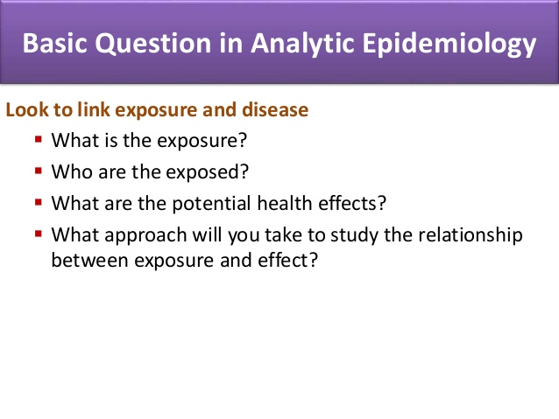

Slide 64
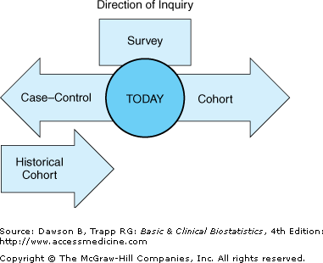

Slide 65
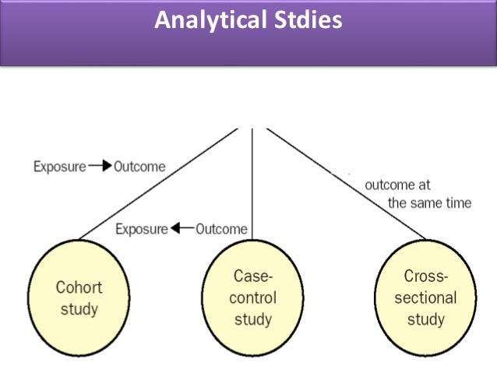

Slide 66
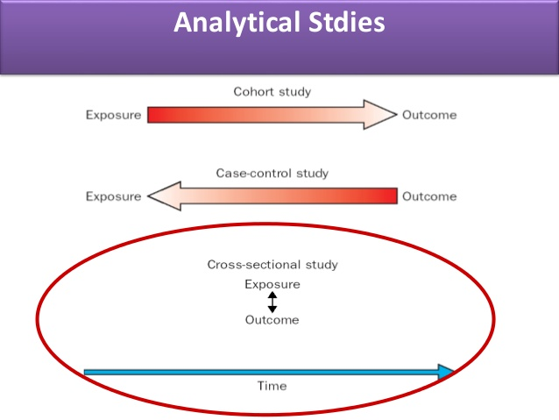

Slide 67
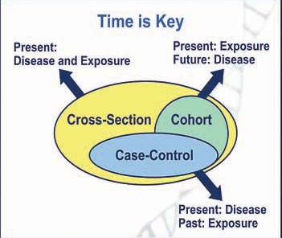

Slide 68
Basic Question in Analytic Research
Are exposure and outcome linked?
E
D
Exposure
Outcome

Slide 69
Cross-sectional studies
Measures exposures and outcomes at a single point in time
time
Study only exists at this point in time

Slide 70
Cross-sectional Design
factor present
No Disease
factor absent
Study
population
factor present
Disease
factor absent
time
Study only exists at this point in time

Slide 71
Cross-sectional Studies
Often used to study conditions that are relatively frequent
Example: community surveys
Not suitable for studying rare or highly fatal diseases or a disease with short duration of expression
Weakest observational design
The temporal association of exposure and effect may be difficult or impossible to determine

Slide 72
Case-Control Studies
An “observational” design comparing exposures in disease cases vs. healthy controls from same population
Exposure data collected retrospectively
Most feasible design where disease outcomes are rare

Slide 73
Case-Control Studies
Retrospective Study - “to look back”, looks back in time to study events that have already occurred
time
Study begins here

Slide 74
Case-Control Studies
Cases: Disease/problem
Controls: No disease

Slide 75
Case-Control Design
factor present
Cases
(disease)
factor absent
Study
population
factor present
Controls
(no disease)
factor absent
present
past
time
Study begins here

Slide 76
Case-Control Study
Strengths
Less expensive and time consuming
Efficient for studying rare diseases
Limitations
Exposure measurements taken after disease occurrence may create bias e.g. recall bias
Problem of control selection

Slide 77
Cohort Studies
Compares individuals with a known risk factor or exposure with others without the risk factor or exposure
Best observational design
Data usually collected prospectively

Slide 78
Cohort Studies
Prospective Study - looks to the future, examines future events, follows a condition, concern or disease into the future
time
Study begins here

Slide 79
Cohort Design
disease
Factor
present
Study
population
free of
disease
no disease
disease
Factor
absent
no disease
present
future
time
Study begins here

Slide 80
Cohort Studies
Exposed
Outcome
Measure exposure
and confounder
variables
Non-exposed
Outcome
Baseline
time
Study begins here

Slide 81
Cohort Study
Strengths
Exposure status determined before disease detection
Subjects selected before disease detection
Can study several outcomes for each exposure
Limitations
Expensive and time-consuming
Inefficient for rare diseases or diseases with long latency
Loss to follow-up

Slide 82
Flow of evidences
Descriptive Studies
Develop
hypothesis
Investigate it’s
relationship to
outcomes
Case-control Studies
Define it’s meaning
with exposures
Cohort Studies
Test link
experimentally
Clinical trials

Slide 83
Experimental studies
Experimental study designs are the primary method for testing the effectiveness of new therapies and other interventions, including innovative drugs.
By the 1930s, the pharmaceutical industry had adopted experimental methods and other research designs to develop and screen new compounds, improve production outputs, and test drugs for therapeutic benefits.
The full potential of experimental methods in drug research was realized in the 1940s and 1950s with the growth in scientific knowledge and industrial technology.

Slide 84
Experimental studies
An experiment is a study designed to compare benefits of an intervention with standard treatments, or no treatment, such as a new drug therapy or prevention program, or to show cause and effect
Experimental designs have numerous advantages compared with other epidemiological methods

Slide 85
Experimental studies
experimental study is that the allocation or assignment of individuals is under control of investigator and thus can be randomized.
The key is that the investigator controls the assignment of the exposure or of the treatment but otherwise symmetry of potential unknown confounders is maintained through randomization. Properly executed experimental studies provide the strongest empirical evidence.
The randomization also provides a better foundation for statistical procedures than do observational studies.

Slide 86
Type of experimental study
Randomized controlled trial (RCT) or clinical trials(with patients as unit of study)
Field trials or community interventional study (with health people as unit of study)
Community trials (with community as unit of study)

Slide 87
Randomized controlled trial (RCT) or clinical trials(with patients as unit of study)
A randomized controlled trial (or randomized control trial; RCT) is a type of scientific (often medical) experiment that aims to reduce certain sources of bias when testing the effectiveness of new treatments.
It is a trial in which subjects are randomly assigned to one of two groups: one (the experimental group) receiving the intervention that is being tested, and the other (the comparison group or control) receiving an alternative (conventional) treatment.
The two groups are then followed up to see if there are any differences between them in the outcome.

Slide 88
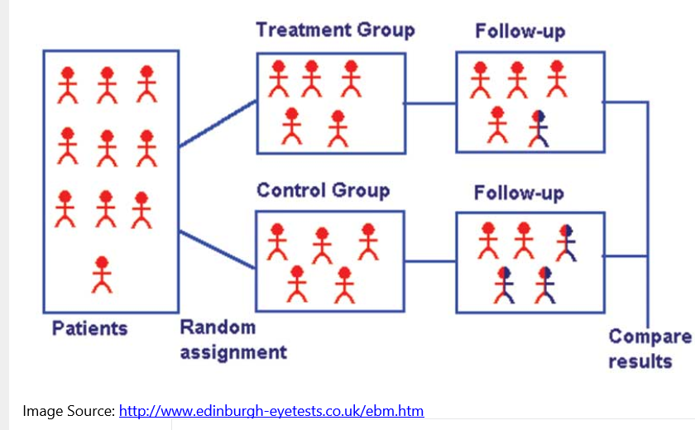

Slide 89
Features of Randomized Controlled Trials (RCTs)
They are randomized: The researchers decide randomly as to which participants in the trial receive the new treatment and which receive a placebo, or fake treatment.
They are controlled: The trial uses a control group for comparison or reference. In the control group, the participants do not receive the new treatment but instead receive a placebo or reference treatment.

Slide 90
Principle of Randomized Controlled Trials (RCTs)
It is accomplished by randomly allocating subjects to two or more groups, treating them differently, and then comparing them with respect to a measured response.
One group—the experimental group—has the intervention being assessed, while the other—usually called the control group—has an alternative condition, such as a placebo or no intervention.
The groups are followed under conditions of the trial design to see how effective the experimental intervention was.
Treatment efficacy is assessed in comparison to the control.
There may be more than one treatment group or more than one control group.
The results and subsequent analysis of the trial are used to assess the effectiveness of the intervention, which is the extent to which treatment, procedure, or service does patients more good than harm.

Slide 91
Steps in Randomized Controlled Trials (RCTs)
The basic steps in conducting an RCT include the following:
Drawing up a protocol.
Selecting reference and experimental populations.
Randomization.
Manipulation or intervention.
Follow-up.
Assessment of outcome

Slide 92
1. The protocol:
One of the essential features of a randomized controlled trial is that the study is conducted under a strict protocol.
The protocol specifies the aims and objectives of the study, questions to be answered, criteria for the selection of study and control groups, size of the sample, the procedures for allocation of subjects into study and control groups, treatments to be applied when and where and how to what kind of patients, standardization of working procedures and schedules as well as responsibilities of the parties involved in the trial, up to the stage of evaluation of outcome of the study.
The protocol aims at preventing bias and to reduce the sources of error in the study.

Slide 93
2. Selecting reference and experimental populations
(a) Reference or target population:
It is the population to which the findings of the trial, if found successful, are expected to be applicable (e.g., a drug, vaccine or other procedure).
A reference population may be as broad as mankind or it may be geographically limited or limited to persons in specific age, sex, occupational or social groups.
(b) Experimental or study population:
The study population is derived from the reference population. It is the actual population that participates in the experimental study.
Ideally, it should be randomly chosen from the reference population, so that it has the same characteristics as the reference population.
If the study population differs from the reference population, it may not be possible to generalize the findings of the study to the reference population.

Slide 94
The participants or volunteers must fulfill the following three criteria:
They must give “informed consent”, that is they must agree to participate in the trial after having been fully informed about the purpose, procedures and possible dangers of the trial;
They should be representative of the population to which they belong (i.e., reference population); and
They should be qualified or eligible for the trial.

Slide 95
3. Randomization
Randomization is a statistical procedure by which the participants are allocated into groups usually called “study” and “control” groups, to receive or not to receive an experimental preventive or therapeutic procedure, maneuver or intervention.
Randomization is an attempt to eliminate “bias” and allow for comparability.
Randomization is the “heart” of a controlled trial. It will give the greatest confidence that the groups are comparable so that “like can be compared with like”.
Randomization is done only after the participant has entered the study that is after having been qualified for the trial and has given his informed consent to participate in the study.
Randomization is best done by using a table of random numbers.

Slide 96
4. Manipulation
Having formed the study and control groups, the next step is to intervene or manipulate the study (experimental) group by the deliberate application or withdrawal or reduction of the suspected causal factor (e.g., this may be a drug, vaccine, dietary component, a habit, etc) as laid down in the protocol.
This manipulation creates an independent variable (e.g., drug, vaccine, a new procedure) whose effect is then determined by measurement of the final outcome, which constitutes the dependent variable (e.g., the incidence of disease, survival time, recovery period).

Slide 97
5. Follow-up
This implies examination of the experimental and control group subjects at defined intervals of time, in a standard manner, with equal intensity, under the same given circumstances, in the same time frame till final assessment of outcome.
The duration of the trial is usually based on the expectation that a significant difference (e.g., mortality) will be demonstrable at a given point in time after the start of the trial.
Thus the follow-up may be short or may require many years depending upon the study undertaken.

Slide 98
6. Assessment
The final step is the assessment of the outcome of the trial in terms of:
(a) Positive results: that is, benefits of the experimental measures such as reduced incidence or severity of the disease, cost to the health service or other appropriate outcomes in the study and control groups.
(b) Negative results: that is, severity and frequency of side-effects and complications, if any, including death. Adverse effects may be missed if they are not sought.
The incidence of positive/negative results is rigorously compared in both the groups and the differences, if any, are tested for statistical significance.
Techniques are available for the analysis of data as they are collected (sequential analysis), but it is more useful to analyze the results at the end of the trial.

Slide 99
Potential Bias in RCTs
Bias may arise from errors of assessment of the outcome due to the human element. These may be from three sources:
First, there may be bias on the part of the participants, who may subjectively feel better or report improvement if they knew they were receiving a new form of treatment. This is known as “subject variation”.
Secondly, there may be observer bias that is the investigator measuring the outcome of a therapeutic trial may be influenced if he knows beforehand the particular procedure or therapy to which the patient has been subjected. This is known as “observer bias.”
Thirdly, there may be bias in evaluation that is, the investigator may subconsciously give a favorable report of the outcome of the trial.

Slide 100
The Blinding Technique
In order to reduce these problems, a technique known as “blinding” is adopted, which will ensure that the outcome is assessed objectively.
Blinding can be done in three ways:
(a) SINGLE BLIND TRIAL: The trial is so planned that the participant is not aware whether he belongs to the study group or control group.
(B) DOUBLE-BLIND TRIAL: The trial is so planned that neither the doctor nor the participant is aware of the group allocation and the treatment received.
(C) TRIPLE BLIND TRIAL: This goes one step further. The participant, the investigator and the person analyzing the data are all “blind”.
Ideally, of course, triple blinding should be used; but the double-blinding is the most frequently used method when a blind trial is conducted.

Slide 101
Significance of Randomized Controlled Trials (RCTs)
Randomized controlled trials are the most reliable method available for testing new treatments.
RCTs are the most stringent way of determining whether a cause-effect relation exists between the intervention and the outcome
They have become the standard that pharmaceutical companies must meet for calculating and proving the level of efficacy and safety of an experimental drug.

Slide 102
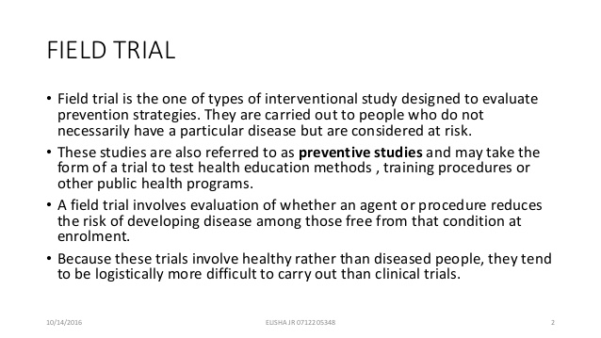
Field trials or community interventional study (with health people as unit of study)

Slide 103
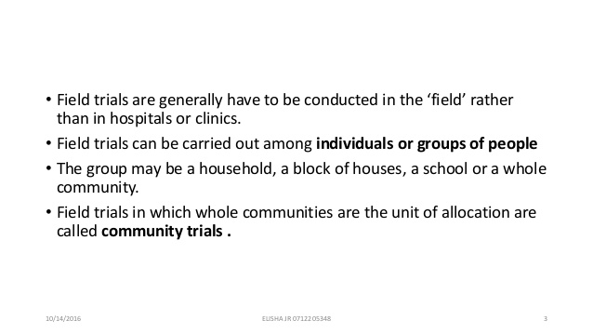
Field trials or community interventional study (with health people as unit of study)

Slide 104
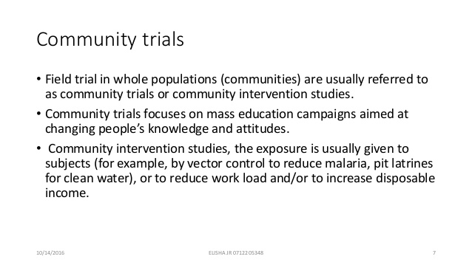
Community trials (with community as a unit of study)

Slide 105


Slide 106
Experimental Studies
Randomized Controlled Trials (RCTs)/Clinical trials
Clinical trials are the most well known experimental studies
The “gold standard” of research designs
Provides most convincing evidence of relationship between exposure and effect
Planned research designs
Involves random assignment to groups design
The ultimate step in testing causal hypotheses

Slide 107
Experimental Design
outcome
RANDOMIZATION
Intervention
no outcome
Study
population
outcome
Control
no outcome
baseline
future
time
Study begins here (baseline point)

Slide 108
Randomized Controlled Trials
Disadvantages
Very expensive
Not appropriate to answer certain types of questions
it may be unethical, for example, to assign persons to certain treatment or comparison groups

Slide 109
Community Trial
Community are randomly assigned into experimental and control group
For prevention, intervention trial are done in some community

Slide 110
Quasi experimental
An Experimental study design always has
Intervention
Random allocation
Comparison group
Usually randomization is missing in quasi-experimental study design
e.g Pre and post intervention study

Slide 111
2. Observational or non-experimental studies
Non-experimental research is research that lacks the manipulation of an independent variable. Rather than manipulating an independent variable, researchers conducting non-experimental research simply measure variables as they naturally occur (in the lab or real world).

Slide 112


